Slide 1


GUIDED BY: MS.TAMANDEEP KAUR LECTURER (SOLITARE INFOSYS)
PROJECT ON HEALTH CARE SYSTEM NETWORK DESIGN
SUBMITTED BY:
PARAS BANSAL
(12205022)
B.TECH ECM-6th semester
(2022-2026)

Slide 2
ABSTRACT OF PROJECT
⬗HEALTH CARE SYSTEM NETWORK DESIGN
⬗ Login Security to Ensure only admin manipulates data.
The Purpose of this network design is to provide all the information of network configuration of the particular area.
This design provides all information like backup system,data center ,and network area .
This project recognizes the need for a more cohesive and interconnected network, where seamless data exchange and collaboration among various departments and medical personnel can occur in real-time

Slide 3
OBJECTIVE
The primary objectives of the project include :
Creating a secure and scalable network that enables rapid data sharing, optimizing network performance to minimize latency and downtime, and implementing stringent security measures to safeguard patient data from cyber threats.
The proposed network design also focuses on incorporating redundancy and disaster recovery mechanisms to ensure uninterrupted access to critical systems, even during unforeseen events.
The "Health care System Network Design" project represents a strategic initiative aimed at revolutionizing the hospital's information infrastructure to meet the growing demands of modern healthcare.

Slide 4
Content
Title
Abstract Of Project
Objective
Introduction To Network Design
Cisco Packet Tracer
Networking Devices
Ip address
Interface Of Hospital System Network Design
Section 1(Data Center)
Section 2(Network Area)
Section 3(Tunnel Area)
Branch Private
Branch Public
Section 4(Wireless Access Point Network Area)

Slide 5
Introduction To Network Design
In my project , I have made a network design for Health care System using different protocols on cisco packet tracer.
So, What is networking ? Let’s discuss about it
NETWORKING :
Computer networking refers to interconnected computing devices that can exchange data and share resources with each other. These networked devices use a system of rules, called communications protocols, to transmit information over physical or wireless technologies.

Slide 6
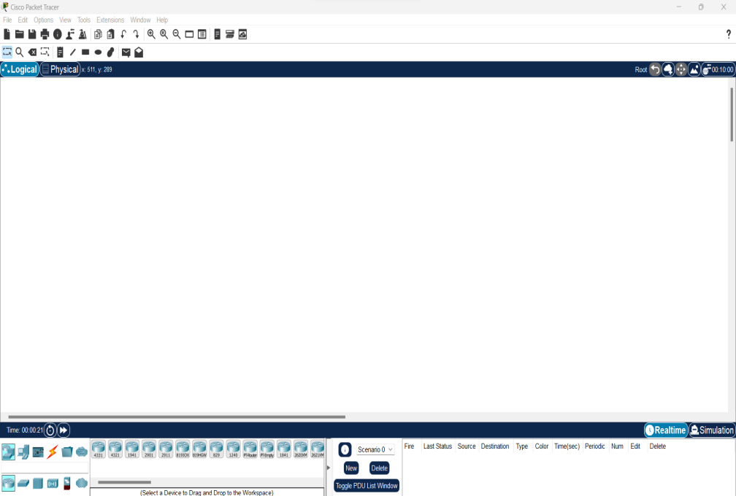
Cisco Packet Tracer
Cisco Packet Tracer is a comprehensive, networking technology teaching and learning program that offers a unique combination of realistic simulation and visualization experiences, assessment and activity authoring capabilities, and opportunities for multiuser collaboration and competition. Packet Tracer enables users to create and simulate various network architectures, ranging from small home networks to complex enterprise setups. It includes a comprehensive set of Cisco devices, such as routers, switches, firewalls, and wireless access points, allowing users to construct virtual networks with ease

Slide 7
Networking Devices
Switch
Switch is also used to connect multiple workstations. Switch is more intelligent than hub. It has special kind of memory called mac address/filter/lookup table. Switch reads mac addresses. Switch stores mac addresses in its filter address table. Switch when receives frame, it reads the destination mac address and consult with its filter table. If he has entry in its filter table then he forwards the frame to that particular mac address, if not found then it performs broadcasting to all its connected nodes
Router
Router is hardware device, which is used to communicate two different networks. Router performs routing and path determination. It does not perform broadcast information. It is is a network layer device which also tells us the best path to the destination

Slide 8
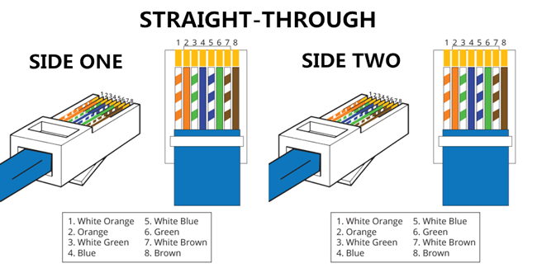
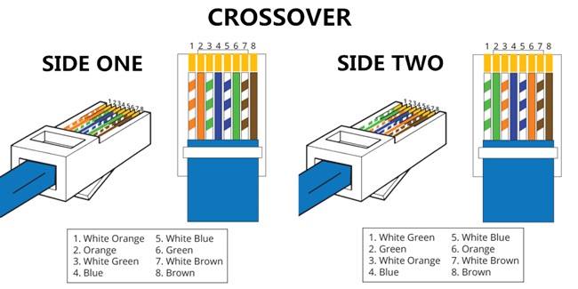
Networking Devices
Cables
Cables are used to connect computers or other devices in a network. There are many types of cables used with LAN as:
1.Copper Straight-Through Cable
2. Copper Cross-Over Cable

Slide 9
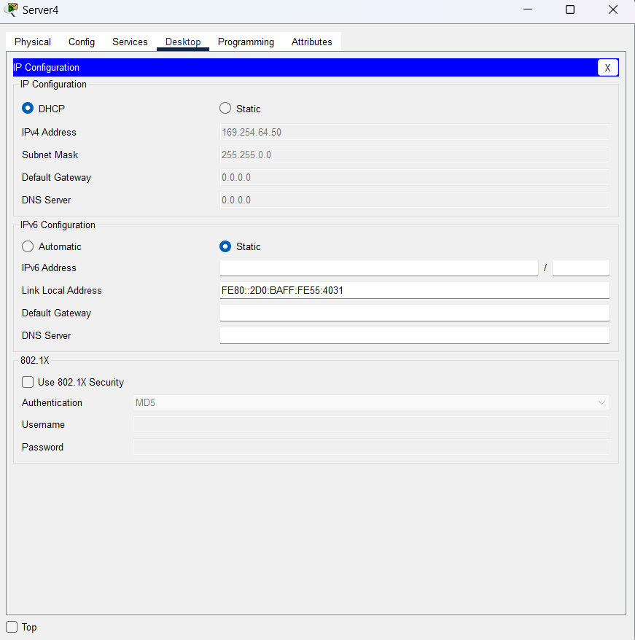
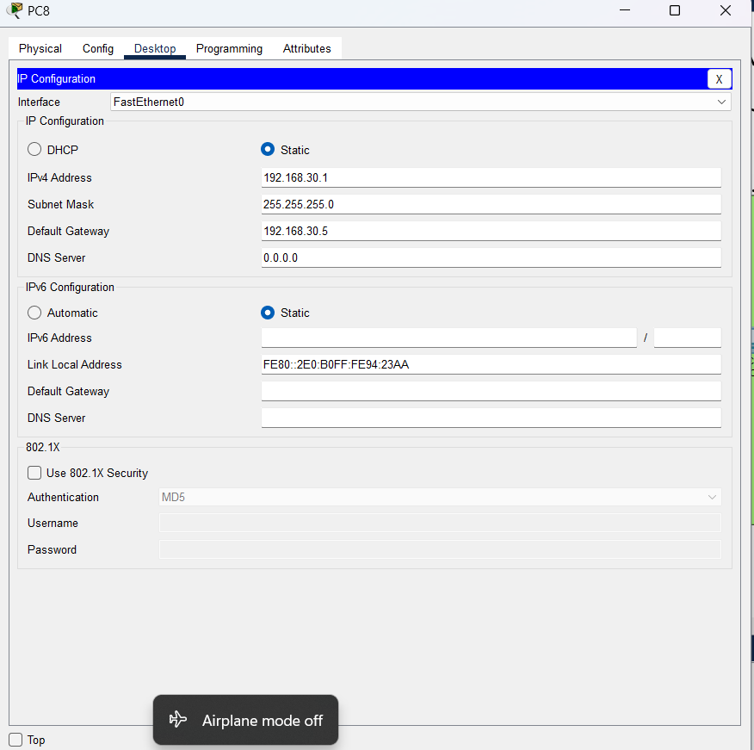
Ip address(IPv4)

Slide 10
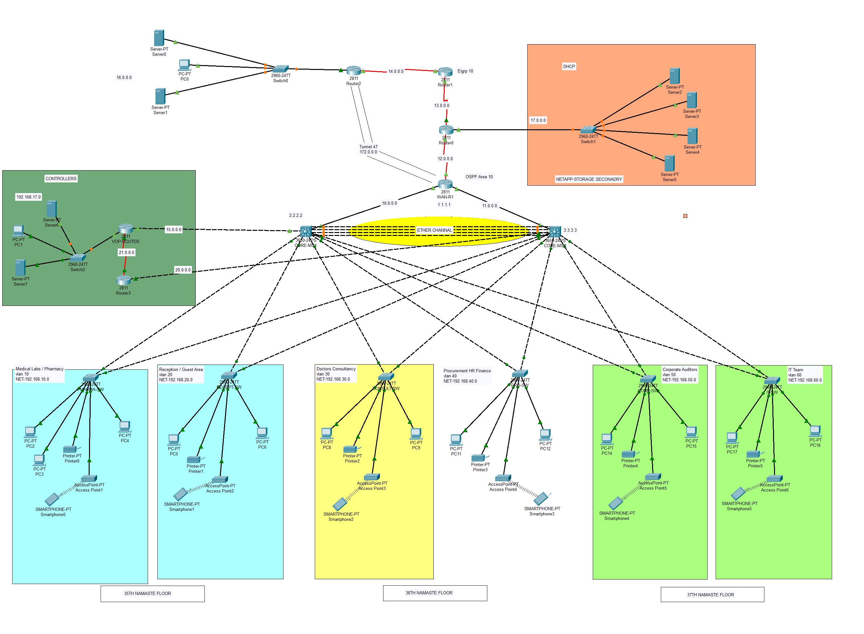
Interface of Health care System Network Design

